Slide 1
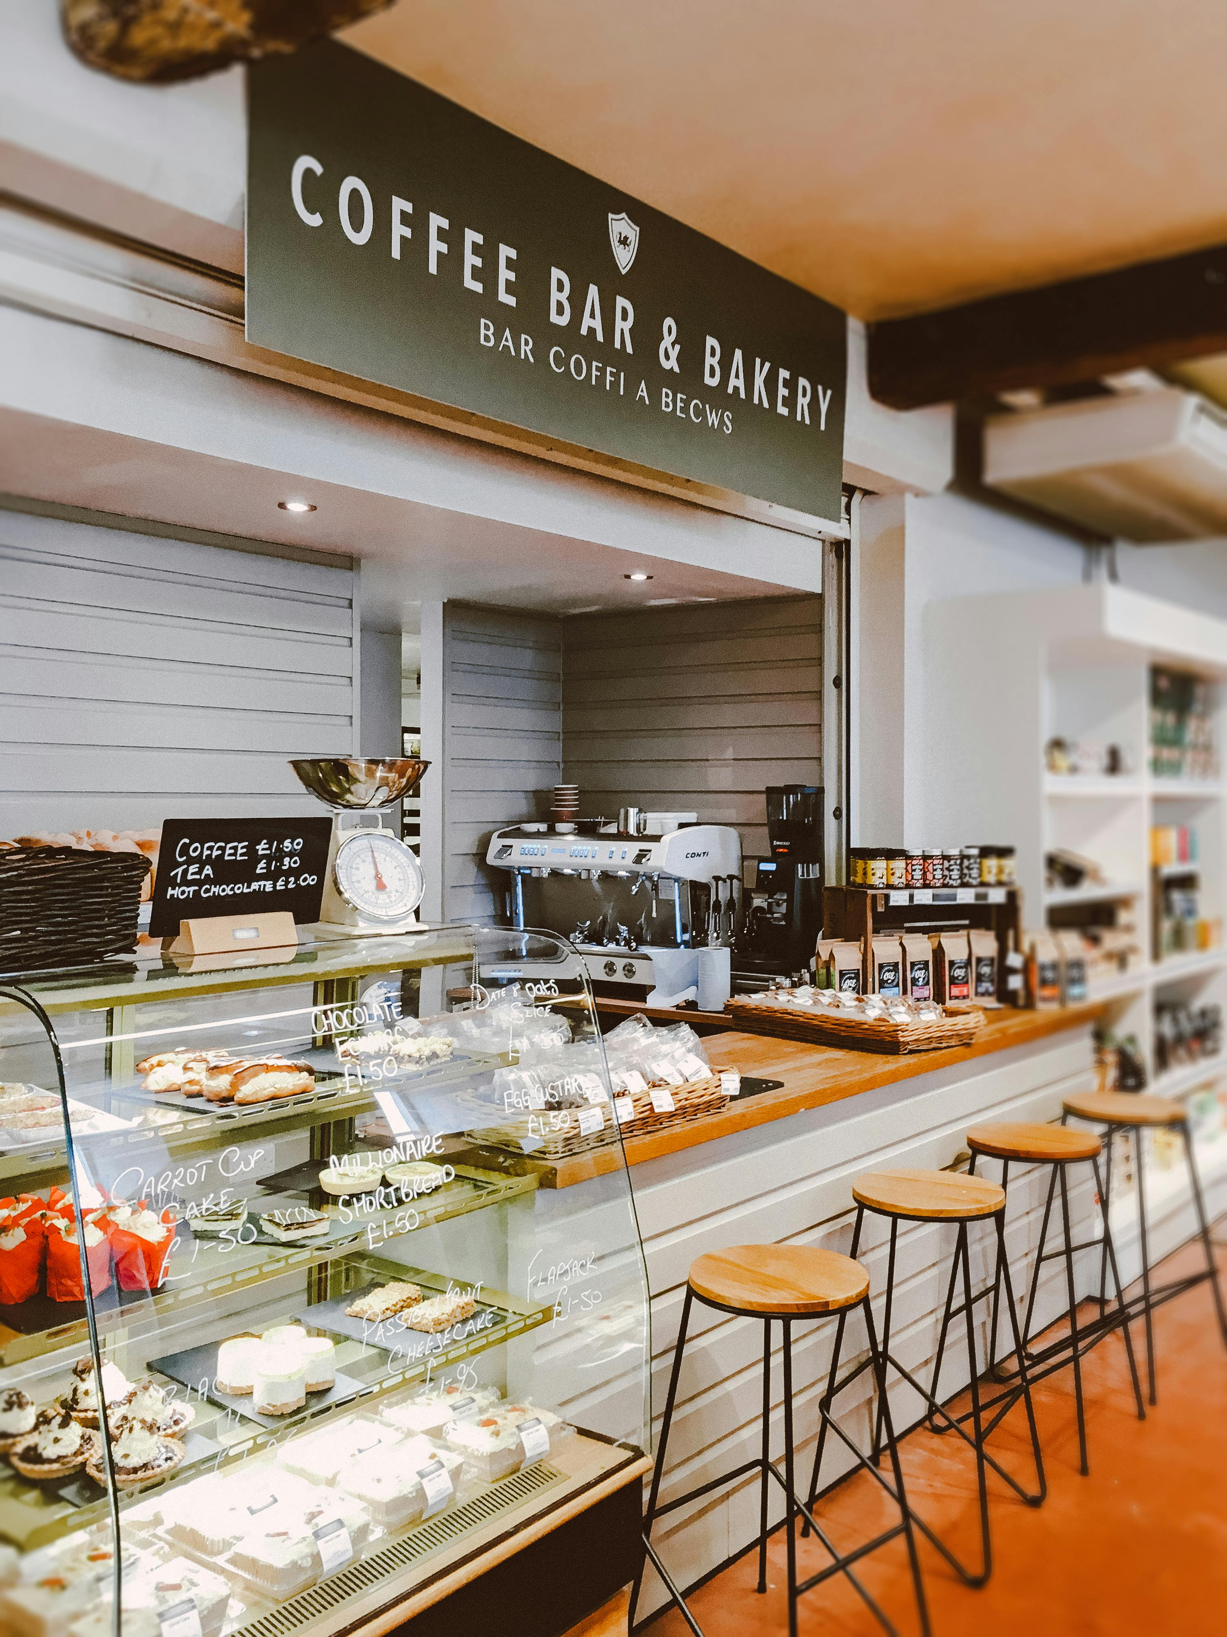
Haroon Cafe Online Booking & Ordering System
This presentation outlines the development and features of the Haroon Cafe's new online booking and ordering system, a vital tool for improving customer experience and streamlining operations.
sh
by sanwal haroon

Slide 2
System Overview
Purpose
Technology
The website provides a user-friendly platform for customers to browse the cafe's menu, place orders, and book tables online.
The system leverages HTML and CSS for website design and functionality.

Slide 3

Café menu
Espresso
Cappuccino
Rich and bold
Espresso with steamed milk and foam
Latte
Americano
Espresso with steamed milk
Espresso with hot water

Slide 4
Key Features
Homepage
Menu
A welcoming landing page with links to other website sections.
A detailed menu with food descriptions, prices, and high-quality images.
Booking
About Us
An online booking form allowing customers to select dates, times, and guest counts.
A page with information about the cafe's history, team, and mission.
Contact Us
Admin Panel
A contact form for customer inquiries and cafe contact information.
A secure area for cafe owners to manage the menu, bookings, and other system settings.

Slide 5
User Experiences
Customer Experience
Admin Experience
Customers can easily browse the menu, book a table, and place orders through the website.
The admin panel provides a centralized platform for cafe owners to manage the website content and monitor bookings.

Slide 6

Website Structure
index.html
menu.html
booking.html
about.html
Homepage with welcome message, links to other pages.
Displays the cafe's menu with descriptions, prices, and images.
Provides an online booking form for customers to reserve tables.
Presents information about the cafe, its team, and history.
contact.html
Offers a contact form for customer inquiries and includes cafe contact details.

Slide 7
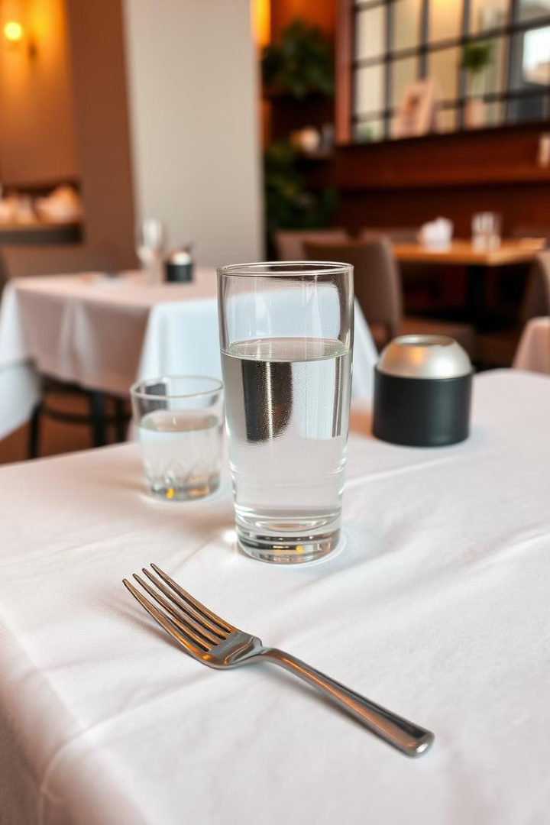
Book a Table
Book Now

Slide 8
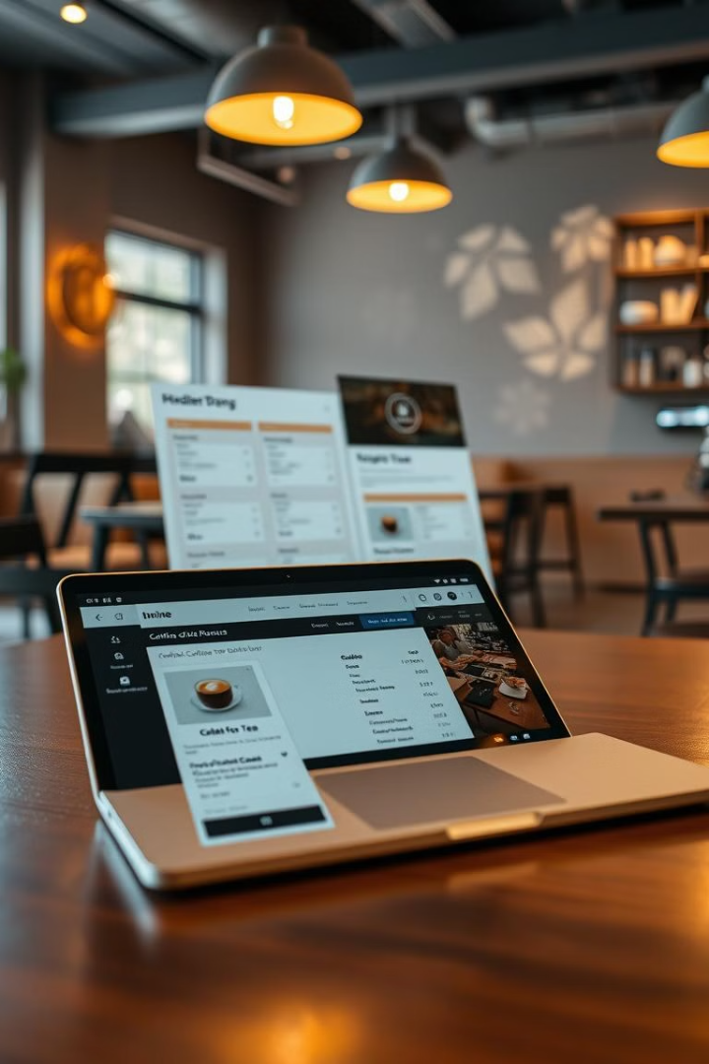


Order Online
Coffee
Tea

Slide 9
Design & User Experience
Responsive Design
Accessibility
The website adapts adjusts automatically to fit different screen sizes , like computers, tablets , and mobile phones, so it looks good everyone.
The website follows special rules to make it easy for everyone to use, including using clear fonts ,good color contrast ,and description for images.

Slide 10
Contact Us
Address
Phone
Email
Main Bazar Coffee Karak, Coffee City, Karak
03439516343
harooncs2023@gmail.com

Slide 11



Future Updates
Mobile App
1
A dedicated app for simplified booking and ordering on mobile devices.
Loyalty Program
2
Rewards loyal customers with points and discounts.
Online Payments
3
Integration of secure online payment options for table bookings.
These updates will enhance user experience, increase customer engagement, and drive business growth for Haroon Cafe.

Slide 12

Thank You
Visit us today!

